Slide 1
Processor organization

Slide 2
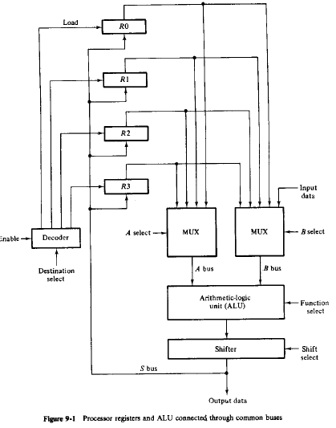
Processor organization

Slide 3
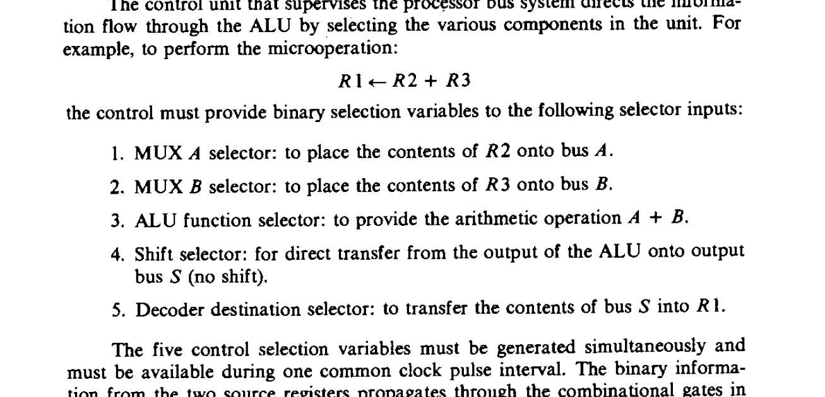

Slide 4

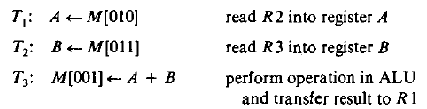
Processor- scratchpad memory
If registers in processor enclosed in memory unit in processor - scratch pad memory
Registers need not be connected through bus, cheaper
The operation
Performed as:

Slide 5
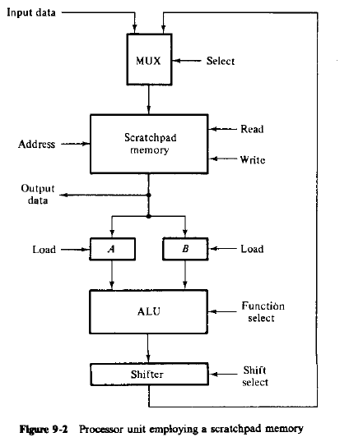

Slide 6
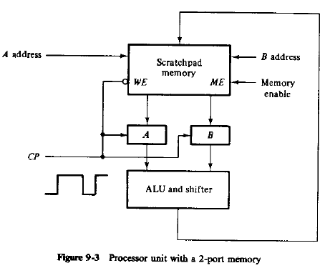
Processor with 2 port memory
To overcome the delay caused when reading two source registers
Has 2 address lines to select 2 words

Slide 7
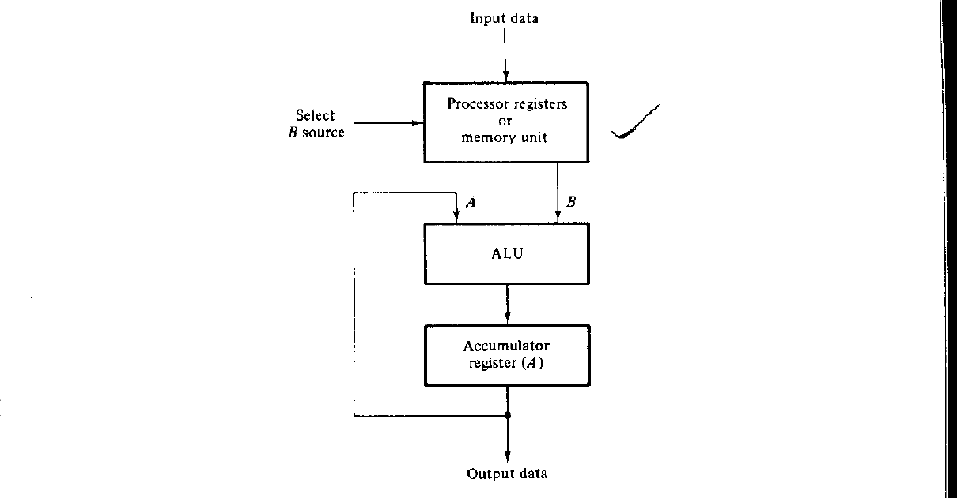
Accumulator Register

Slide 8
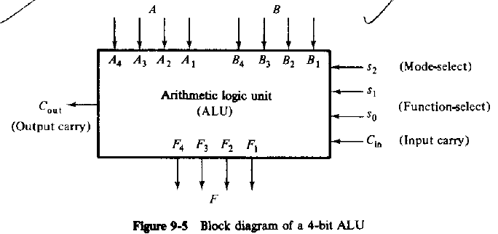
Design of arithmetic and logic circuits

Slide 9
Implemented in 3 steps:
Design of arithmetic section
Design of logic section
Modification of arithmetic section to include logic too

Slide 10
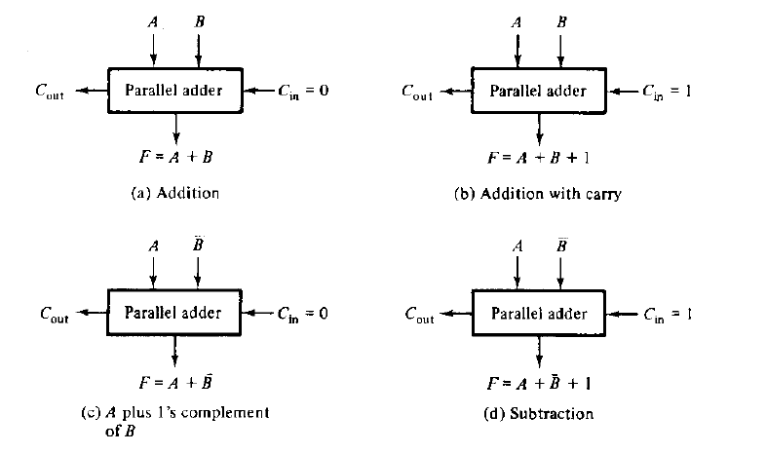
Design of arithmetic circuit
Basic component – parallel adder

Slide 11
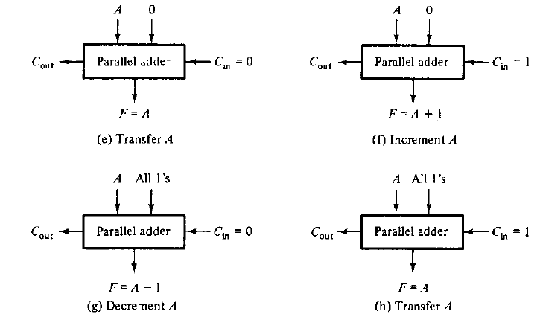

Slide 12

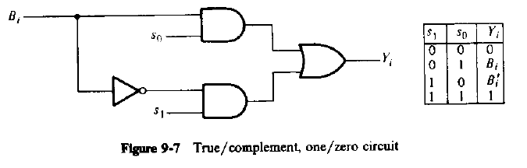
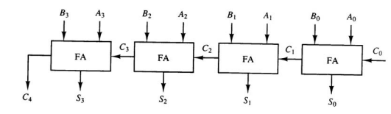

Slide 13
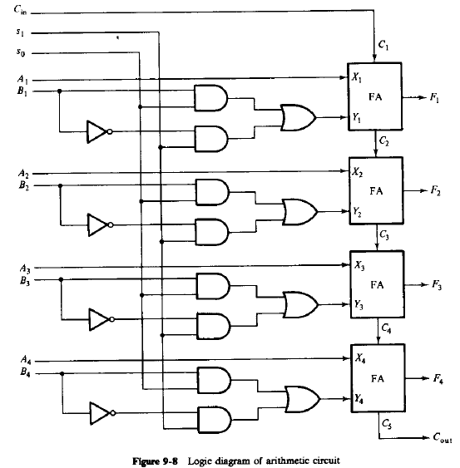

Slide 14
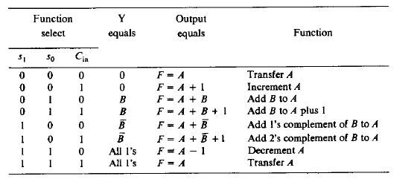

Slide 15
What will be the effect on output carry in the circuit?

Slide 16
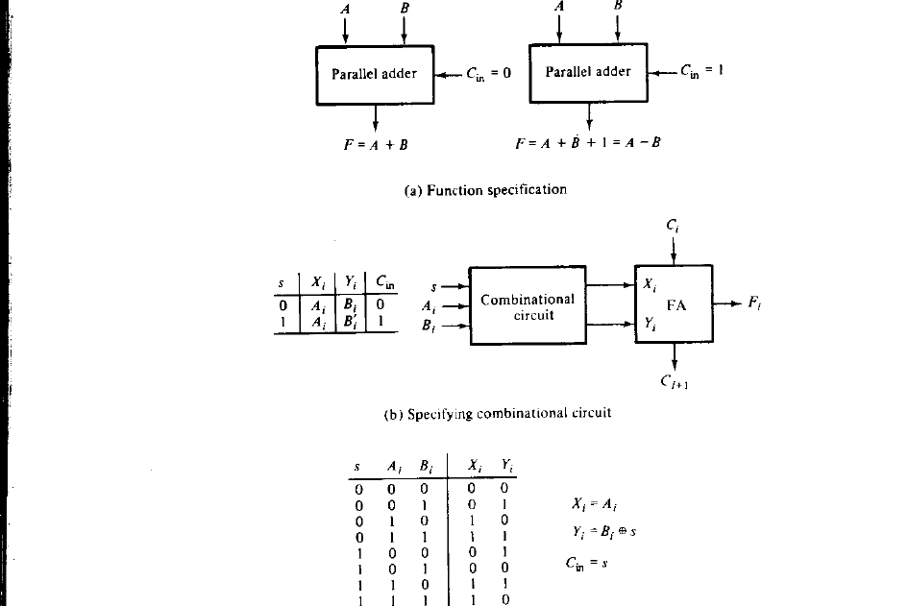
Other Arithmetic Circuits

Slide 17
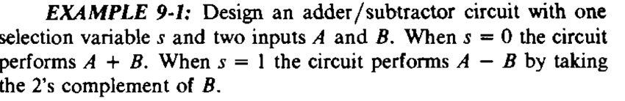

Slide 18
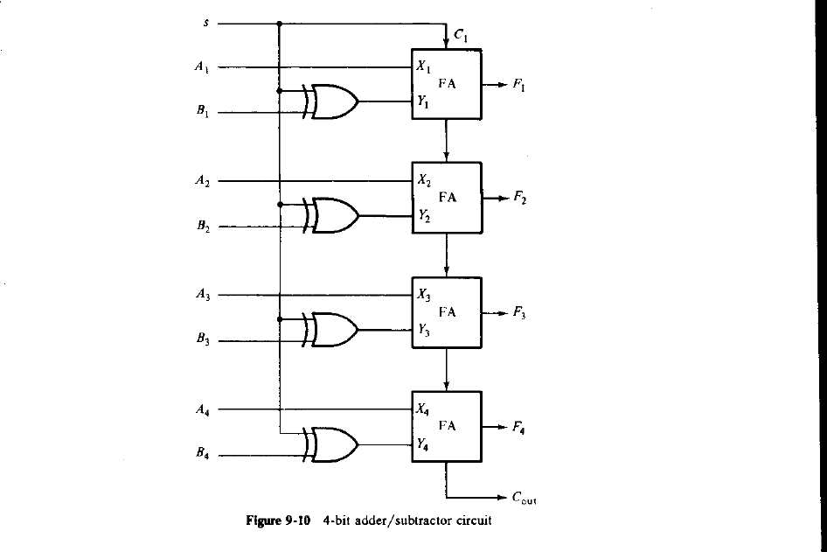
Design of Example

Slide 19
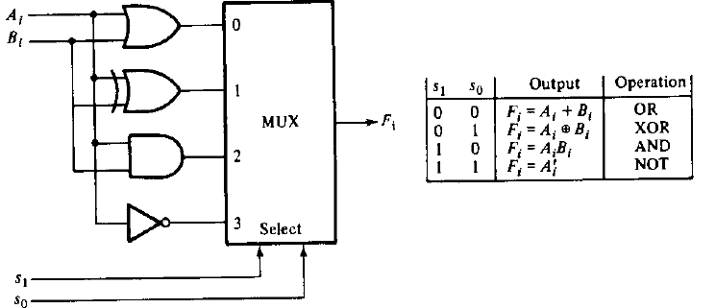
Design of logic circuit

Slide 20
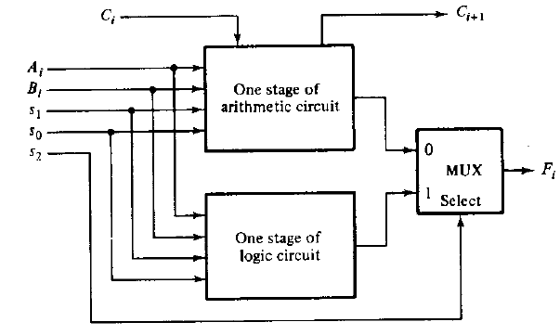
Combining arithmetic and logic units

Slide 21
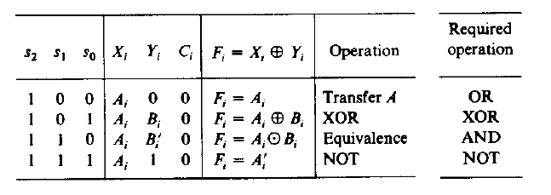
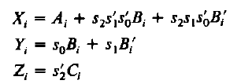

Slide 22
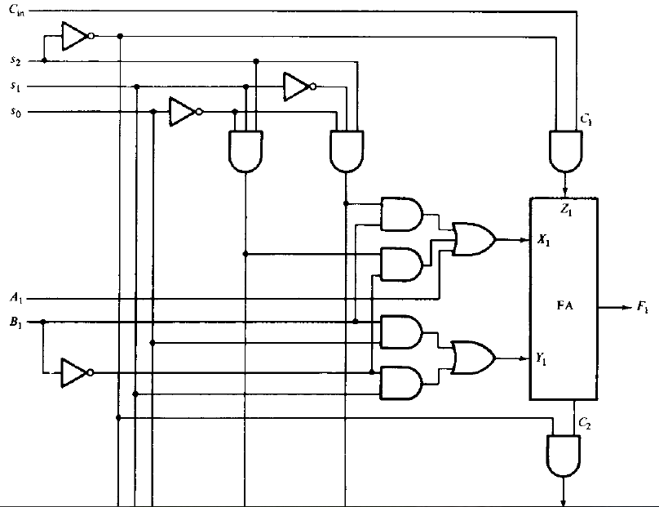

Slide 23
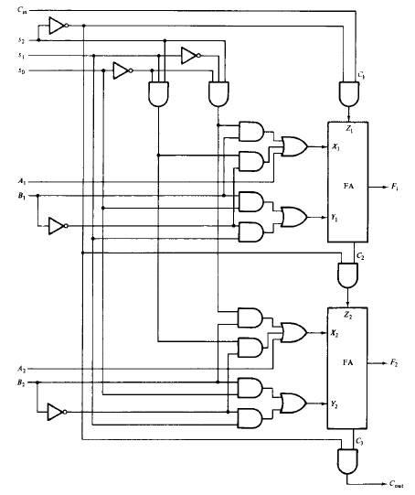
Logic diagram of ALU

Slide 24
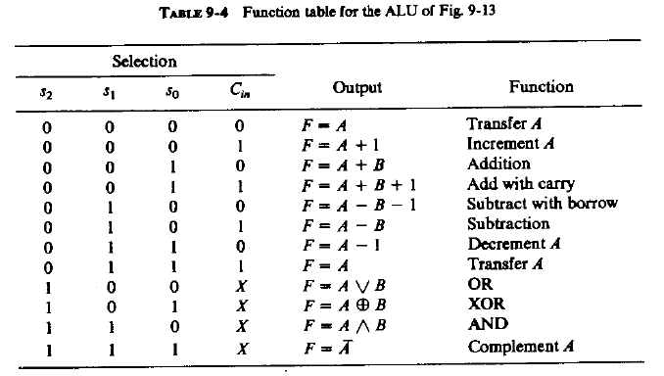

Slide 25
STATUS REGISTER
Condition code/flag- C,S,Z,V
C(carry flag): set if output carry is 1
S(Sign flag): set if highest order bit is 1
Z(Zero flag): set if output has all 1’s
If set after XOR, A,B same
V(Overflow): set if there is overflow

Slide 26
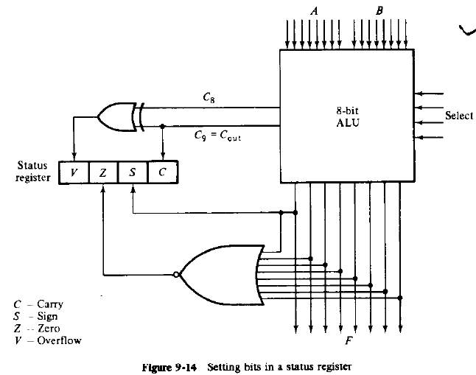

Slide 27
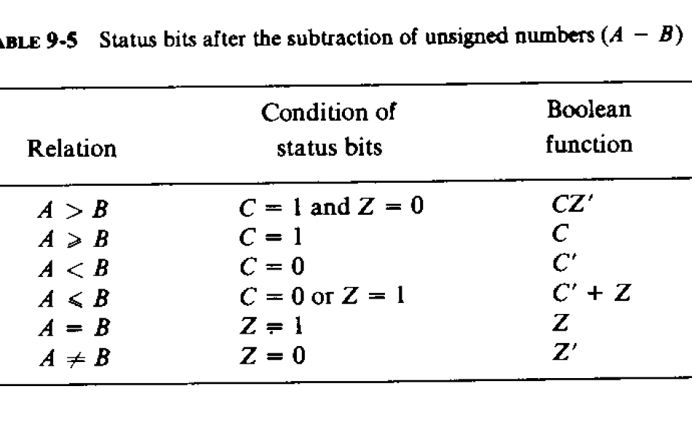
Status Register

Slide 28
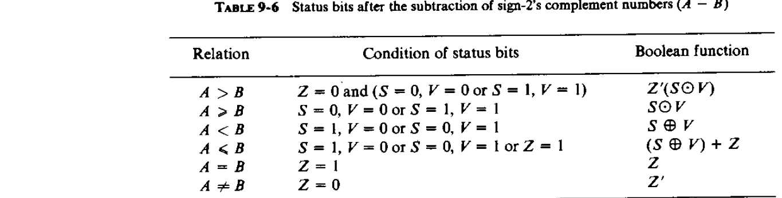
Status Register

Slide 29
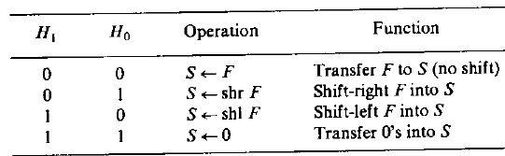
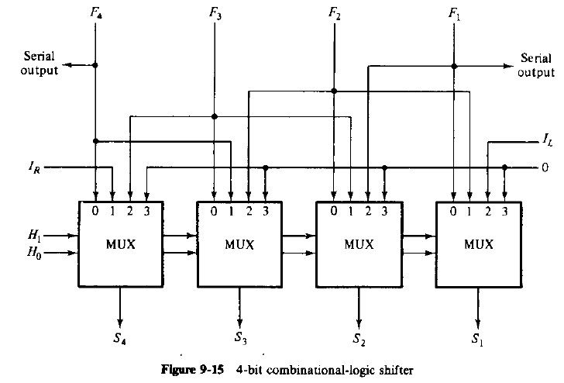
Shifter

Slide 30
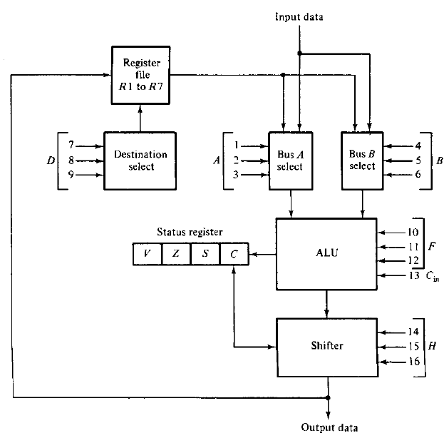
Processor unit

Slide 31
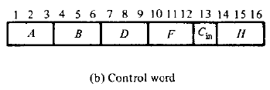
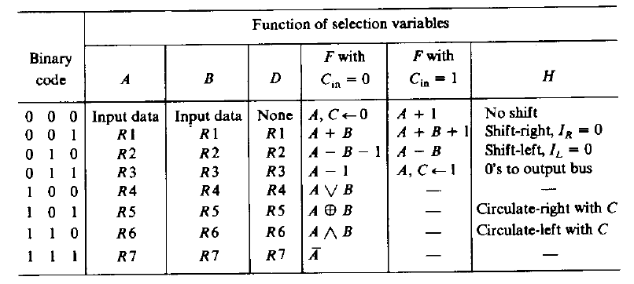

Slide 32
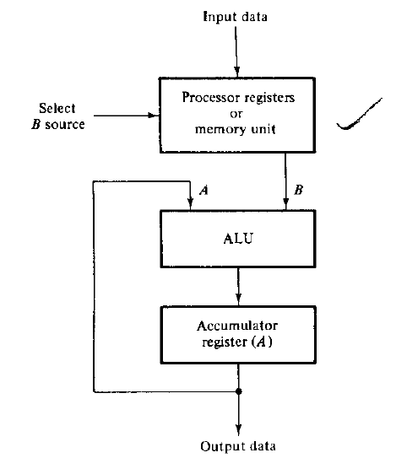
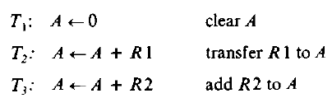
Accumulator register

Slide 33
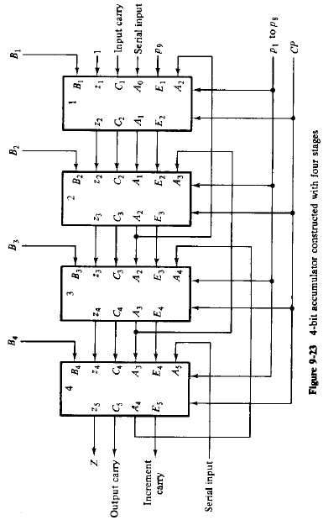
Accumulator design
N bit accumulator needs n stages connected in cascade
Each stage have a JK flipflop with associated circuitries

Slide 34
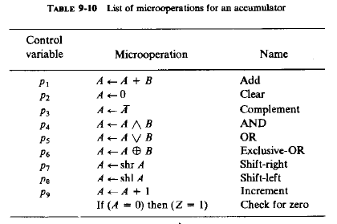
Accumulator design

Slide 35
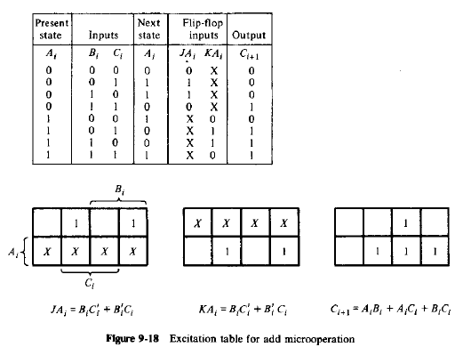

Accumulator design

Slide 36


Accumulator design
Accumulator: clear
Complement

Slide 37
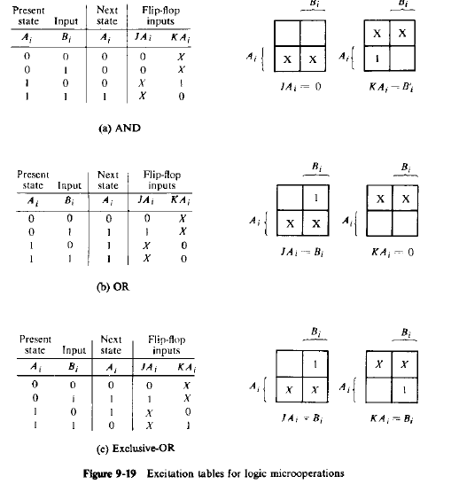

Slide 38


One stage accumulator

Slide 39
